Slide 1
Introduction to Computing
Computer Virus

Slide 2
In the beginning, man created the virus, and it was bad.
The first computer virus
Several stories
Pakistani Brain Virus (1986): This is the first widely spread IBM Compatible virus. This is commonly mistaken for the first virus.
Apple Virus 1 (1981): Boot sector infecting virus. Possibly created for pirated games.
Animal (1975) (Univac): “Guess an animal” game. Copied to other users’ home directories when run.

Slide 3
Introduction
A virus is a program that attaches itself to some form of host such as legitimate, executable program.
Virus lives within the program, which is said to be ‘infected’.
Execution of the host program implies execution of the virus.
May or may not damage the infected program.
A virus is able to replicate
Creates (possibly modified) copies of itself.

Slide 4
Viruses
Needs to have some form of distribution such as via disks or a computer network.
Examples: W95.CIH (Chernobyl), Sampo and Hare

Slide 5
Classifying Viruses: categories
Boot Sector
TSR (Terminate and stay resident)
Multipartite
Macro
Companion
Polymorphic

Slide 6
Boot Sector
Infects the boot sector on a disk replaces the original boot sector with itself
stores the original boot sector somewhere else or replaces it totally
Virus takes control when the system is booted from the diskette may infect other diskettes that are inserted, unless they are write protected may also infects hard disks

Slide 7
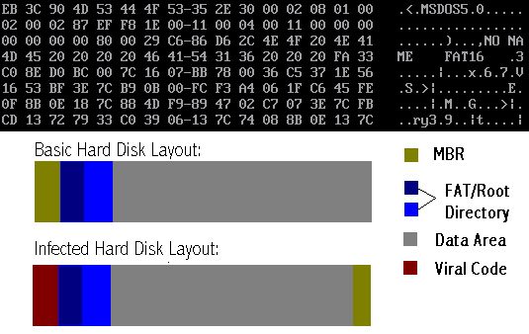
Master Boot Record/Boot Sector Viruses
Boot sector virus (Apple Viruses 1,2,3, “Elk Cloner”), Pakistani Brain (x86)

Slide 8
TSR
A terminate and stay resident (TSR) virus is a virus that stays active in memory after the application (or bootstrapping, or disk mounting) has terminated. TSR viruses can be boot sector infectors or executable infectors. The Brain virus is a TSR virus.

Slide 9
Multipartite
A multipartite virus is a virus that can infect either boot sectors or executables.
Such a virus typically has two parts, one for each type.
When it infects an executable, it acts as an executable infector.
When it infects a boot sector, it works as a boot sector infector.

Slide 10
Macro
A macro virus is a virus composed of a sequence of instructions that is interpreted rather than executed directly.
Macro viruses can infect either executables (Duff’s shell virus) or data files (Highland’s Lotus 1-2-3 spreadsheet virus).
Duff’s shell virus can execute on any system that can interpret the instructions

Slide 11
Macro
Piece of self-replicating code written in an
application's macro language
a macro virus requires an auto-execute macro
one which is executed in response to some event
e.g opening or closing a file or starting an application
once the macro virus is running, it can copy itself to other documents delete files, etc.

Slide 12
Polymorphic
A virus may be encrypted to try to disguise itself and hide what it does
For an encrypted virus to actually run, it has to decrypt its code and data
The portion that does this is referred to as a
decryptor
Encryption techniques can use random keys to make the virus code hard to spot
However the decryptor itself will have a signature

Slide 13
Polymorphic
A polymorphic virus is a randomly encrypted virus that is also programmed to randomly vary its decryption routine

Slide 14
Viruses Types:
Worms
Trojan Horse
Bombs

Slide 15
Computer Worm
A self-replicating computer program, similar to a computer virus
Unlike a virus, it is self-contained and does not need to be part of another program to propagate itself
Often designed to exploit computers’ file transmission capabilities

Slide 16
Worm
A program or algorithm that replicates itself over a computer network or through e-mail and sometimes performs malicious actions such as using up the computer and network resources and possibly destroying data.
Examples: Klez, Nimda, Code Red

Slide 17
Computer Worm
In addition to replication, a worm may be designed to:
Delete files on a host system
Send documents via email
Carry other executables as a payload

Slide 18
Trojan
A malicious program disguised as legitimate software Cannot replicate itself, in contrast to some other types of “malware” like worms and viruses
but they can be contained within a worm.
Depending on their purpose, a Trojan can be destructive or a resource hog and is almost always considered a root compromise.
Ex: Back Orifice, NetBus, SubSeven

Slide 19
Can legitimate networking tools be considered Trojans?
Yes! Many applications are installed by hackers and worms that would be considered legitimate tools. If they were not installed by you and are being used for malicious purposes, they are considered Trojans … even though your antivirus software will not detect them as such.

Slide 20
Logic Bomb
“Slag code”
Programming code, inserted surreptitiously, designed to execute (or “explode”) under particular circumstances

Slide 21
Logic Bomb
Does not replicate
Essentially a delayed-action computer virus or Trojan horse

Slide 22
How do viruses work? (Characteristics)
Once a virus gains access to a computer, its effects can vary.
Possible attacks include:
Replicating itself
Interrupting system/network use
Modifying configuration settings
Flashing BIOS
Format hard drive/destroy data
Using computer/network resources
Distribution of confidential info
Denial of Service attacks

Slide 23
Typical methods of infection
Removable media or drives
Downloading Internet files
E-mail attachments
Unpatched software and services
Poor Administrator passwords
Poor shared passwords

Slide 24
Computer Security
Virus prevention
Patching the operating system
Patching services
Patching client software
Passwords
Antivirus software
Firewalls

Slide 25
Passwords
As discussed earlier when talking about Trojans, strong passwords are a vital part of keeping your systems free of infection.
Antivirus software does not catch the majority of the Trojans . These Trojans are typically legitimate networking tools that were never intended to be used as a Trojan.

Slide 26
Passwords
Having strong passwords will deter most worms and scanners that attempt to crack passwords as a means of entry.
The Administrator account and those users who have Administrator privileges are at the greatest risk, but all users on the network should follow the same password policy.

Slide 27
Virus Detection (Antivirus software)
The primary method of detection of antivirus software is to check programs and files on a system for virus signatures. However, good antivirus software uses many methods to search the system for viruses.

Slide 28
Antivirus Software
AV software considerations
Features
Cost (per workstation/server)
Frequency of updates
Ease of update installation
Server administration
Certification

Slide 29
Antivirus software options
Aladdin Knowledge
Alwil Software
AVG Antivirus
Central Command
Command Software
Computer Associates
Data Fellows Corp.
Dr. Solomon’s Software
ESET Software
Finjan Software
Frisk Software
Kaspersky Lab
McAfee
Network Associates
Norman Data Defense
Panda Software
Proland Software
Sophos
Symantec Corporation
Trend Micro, Inc.

Slide 30
Cleaning viruses
Cleaning viruses depends entirely on your local antivirus solution. The virus must be identified before it can be removed, so it makes sense to try your antivirus scanner first.
If your software identifies, but can’t remove the virus, check the manufacturer’s website for manual removal instructions.

Slide 31
Perform Basic Computer Safety Maintenance
Use an Internet “firewall”
Update your computer
Use up-to-date antivirus software

Slide 32
Use an Internet Firewall
A firewall is software or hardware that creates a protective barrier between your computer and potentially damaging content on the Internet or network.
The firewall helps to guard your computer against malicious users, and also against malicious software such as computer viruses and worms.

Slide 33
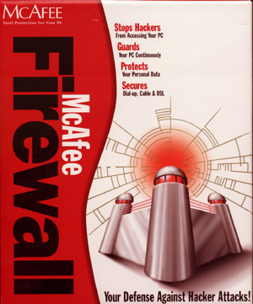
Use an Internet Firewall
Commercial hardware and software firewalls may also be used

Slide 34
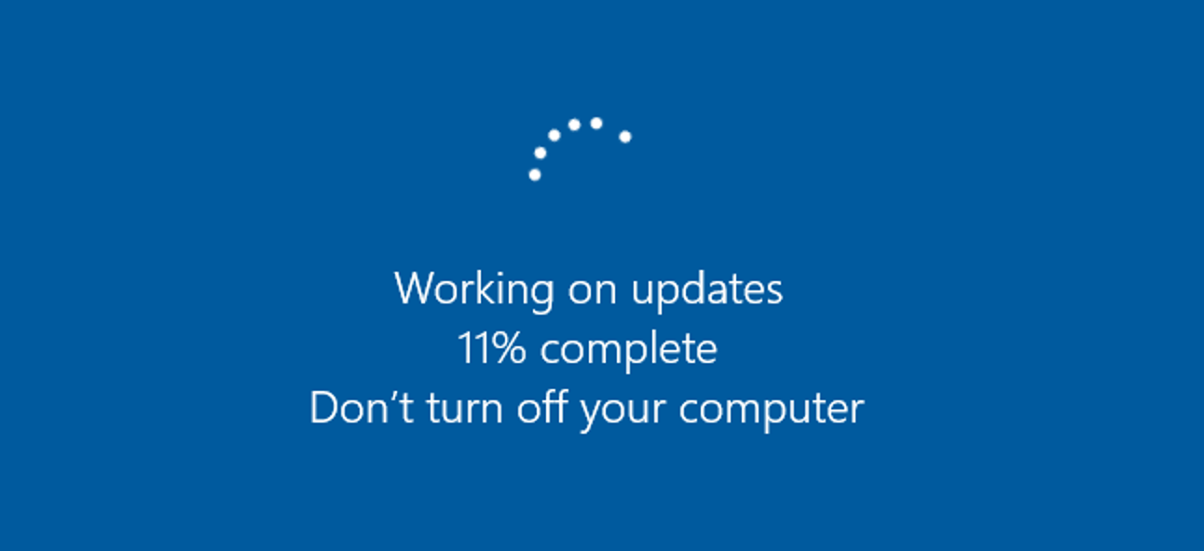
“Update” Your Computer
Download service packs and updates

Slide 35
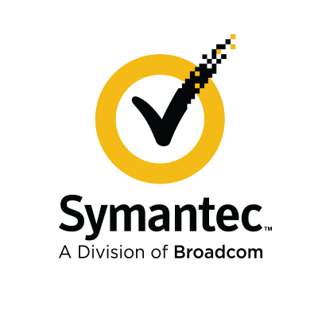
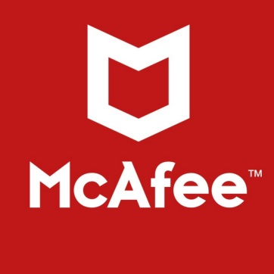



Use Up-to-date Antivirus Software
McAfee and Symantec are prominent vendors
Make certain to keep “virus definitions” up-to-date

